Slide 1
Ray Tracing for Games
Dr. Jacco Bikker - FEL/CVUT, Prague, March 9 - 20
Welcome!
Vítejte!

Slide 2
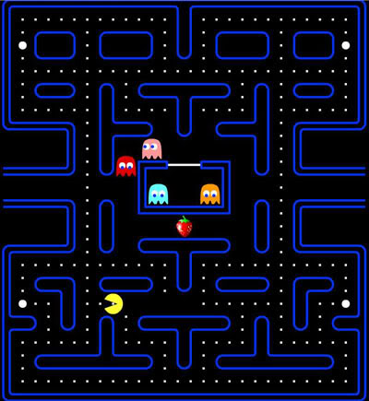
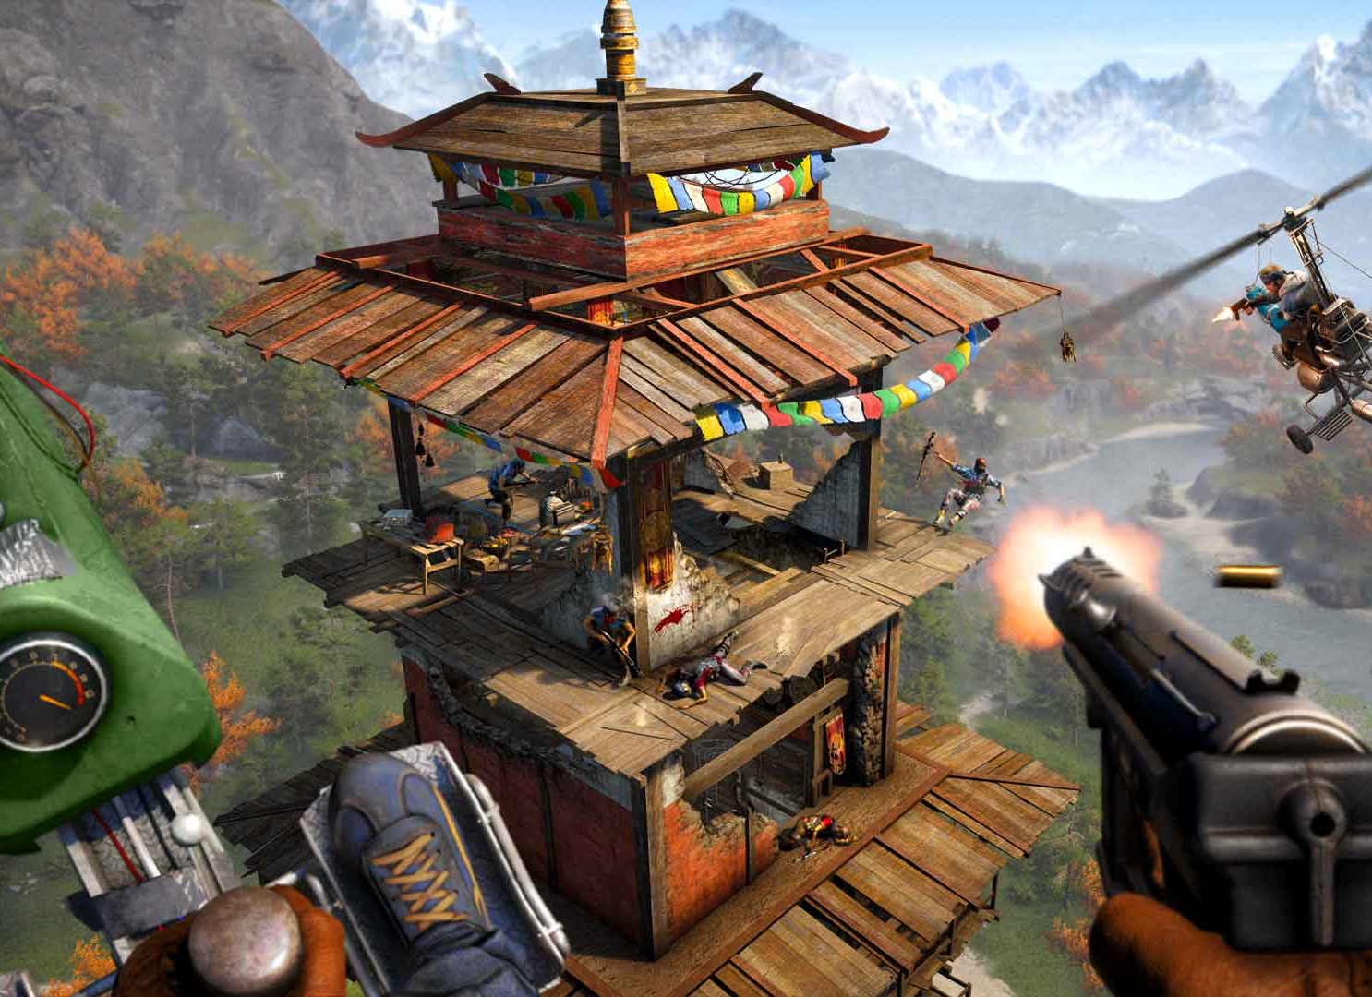
Ray Tracing for Games
Agenda:
Introduction
Game development
Game Architecture
Project Introduction

Slide 3

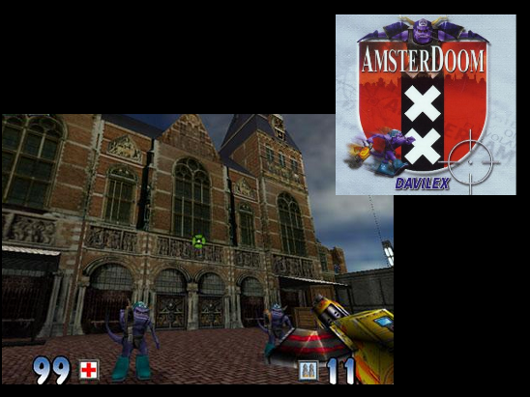
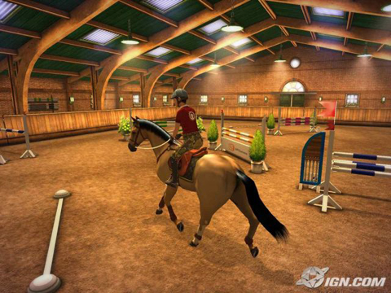
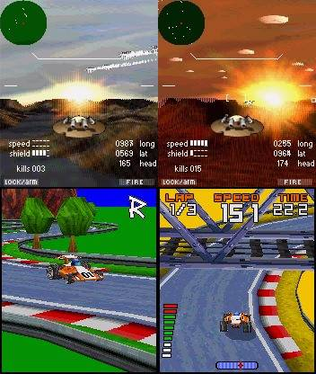
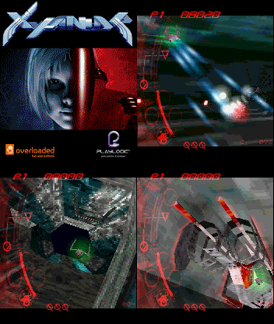
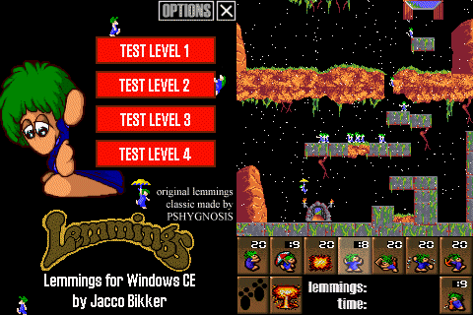
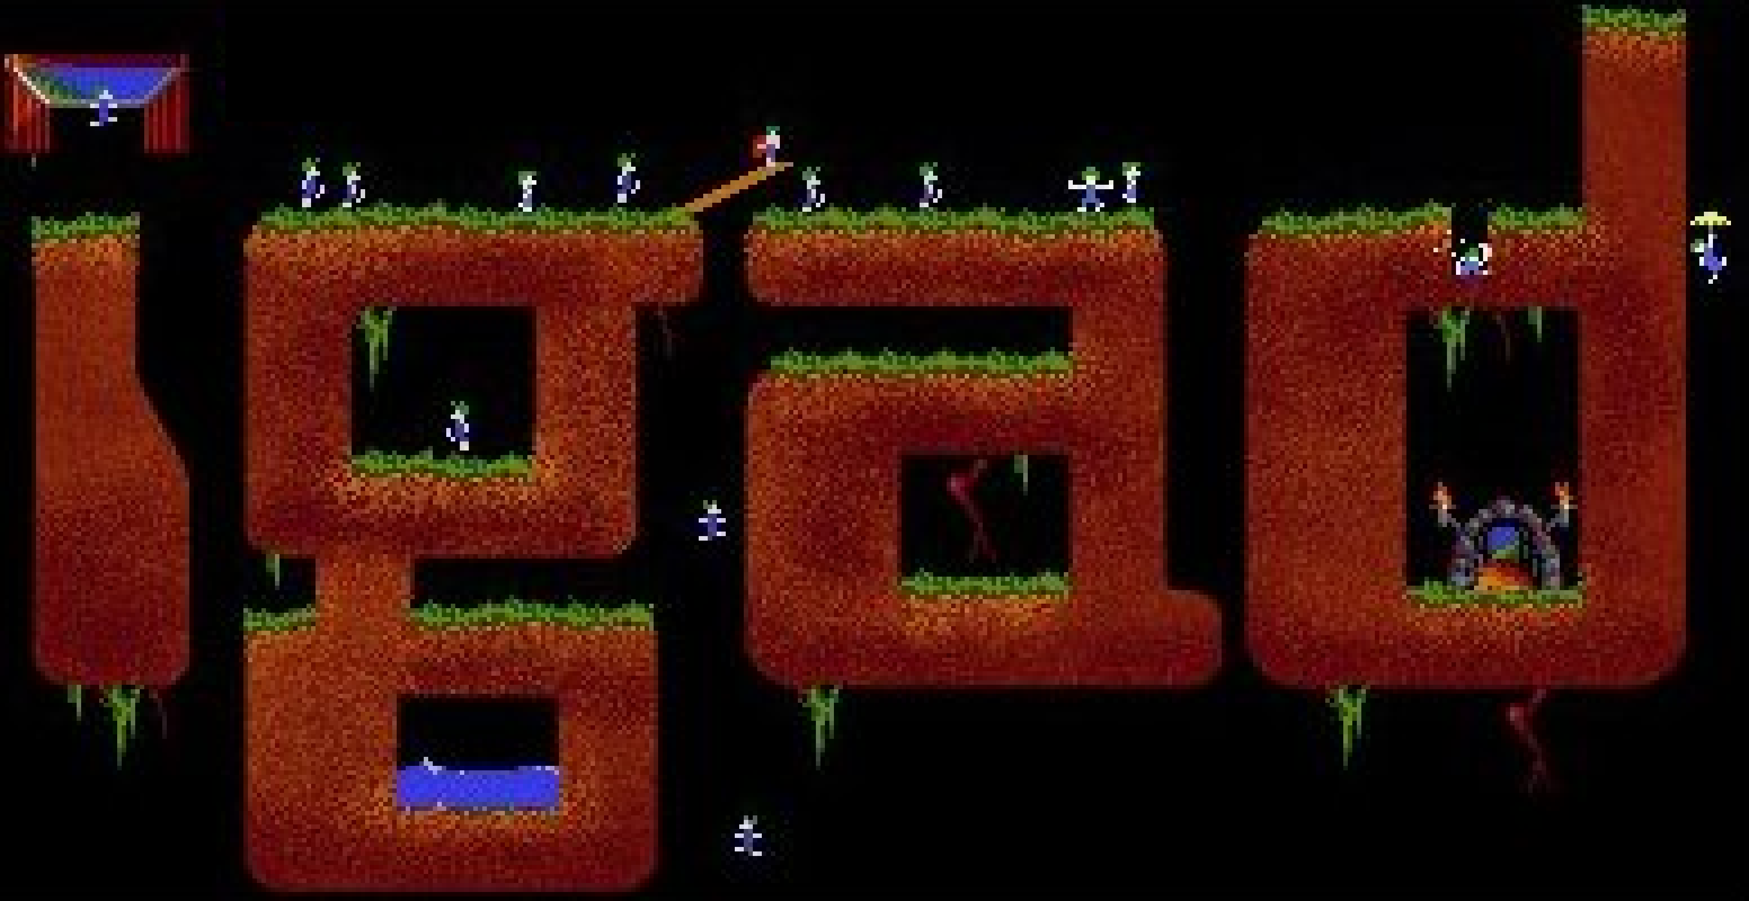
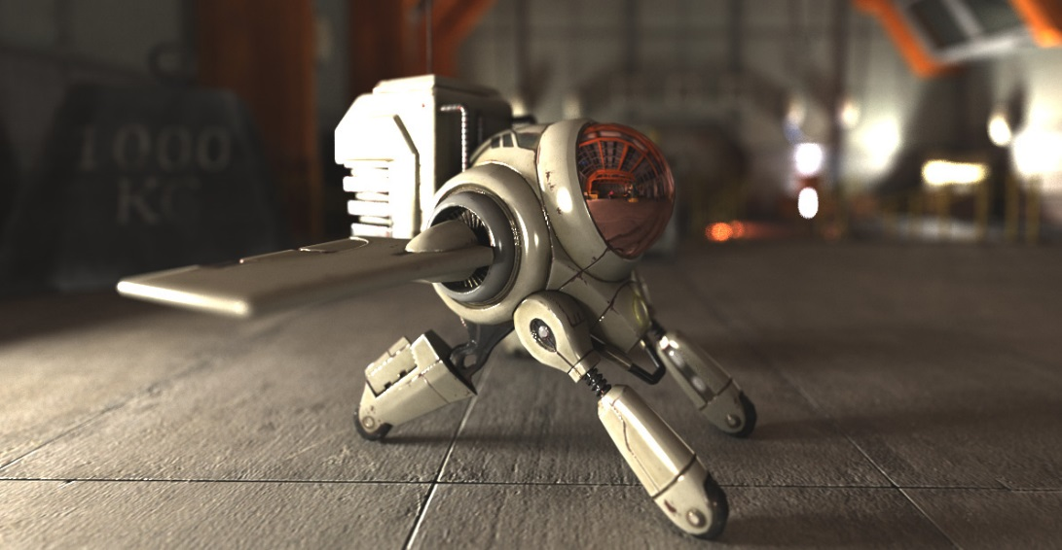
Ray Tracing for Games
Introduction
Lecturer: Dr. Jacco Bikker
Notes:
Hi my name is Jacco Bikker, I am a lecturer at the University of Utrecht in the Netherlands. I used to work in the game industry, on PC titels such as Amsterdoom (which no-one has ever heard of) and mobile titles such as Xyanide, Resistance and Phantom Overdrive.

Slide 4
Ray Tracing for Games
Introduction
This course:
9 lectures + lab
Practice > theory
C++, close to the metal
1: graphics (rasterization, ray tracing)
2: games (architecture, optimization)
Team effort
> 3h
Grade: project + exam

Slide 5
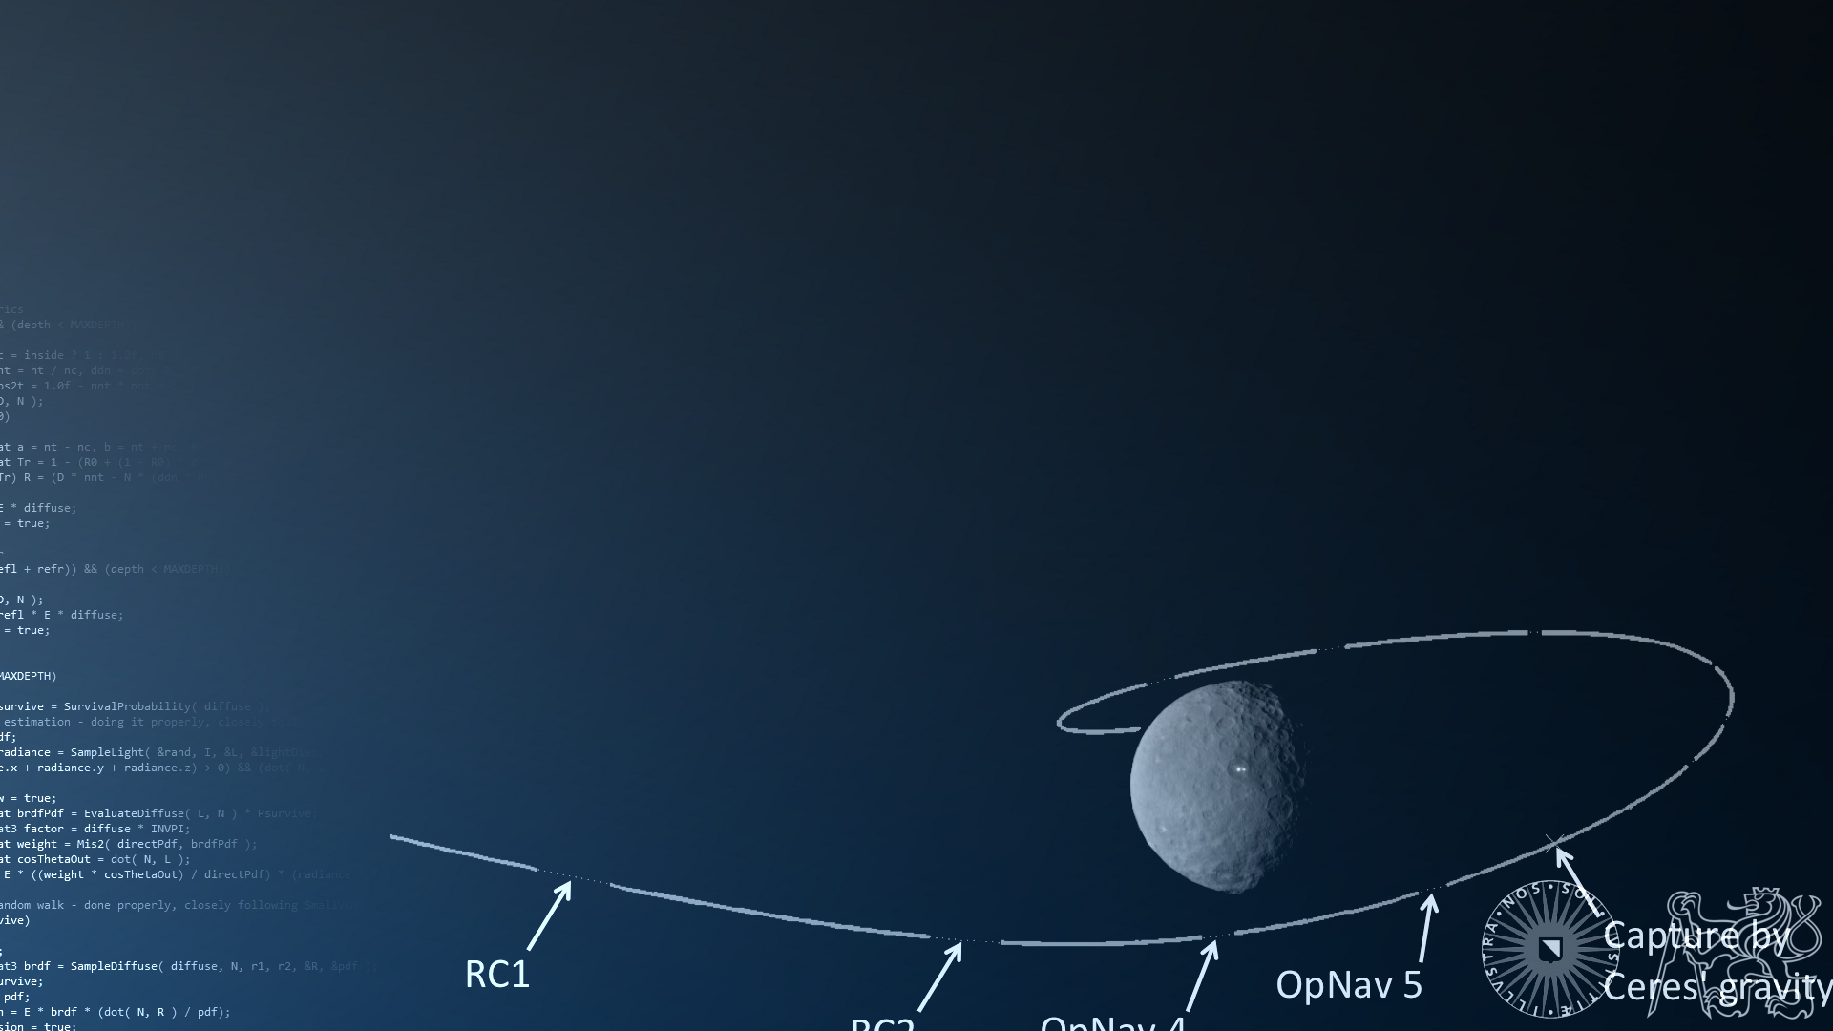
Ray Tracing for Games
Introduction
Mission objectives:
Build a small game on a basic 3D engine;
Add ‘take a photo’ functionality using ray tracing;
Make the ray tracer real-time;
Pick up a thing or two on various topics;
Report on progress.

Slide 6
Ray Tracing for Games
Introduction
Mission prerequisits:
I am assuming you have some time this week;
We’ll use C++ only in this course;
We’ll use a special template to get started.

Slide 7

Ray Tracing for Games
Introduction
Special template:
Designed for rapid prototyping
Very minimalistic
For this course: including rasterizer
This template (and the rasterizer) are designed to be modified by you.

Slide 8
Ray Tracing for Games

Slide 9
Ray Tracing for Games
You get a software rasterizer because you will be adding a ray tracer. Please do not replace it with an OpenGL renderer.
Also, it’s <500 lines, and the manual is 1 page. That helps.

Slide 10
Ray Tracing for Games
Introduction
Team members – Pick your role!
Graphics programmer
Game programmer
Tools & Assets
You may want to keep your preferred role in mind for the remainder of these slides.

Slide 11
Ray Tracing for Games
Agenda:
Introduction
Game development
Game Architecture
Project Introduction

Slide 12

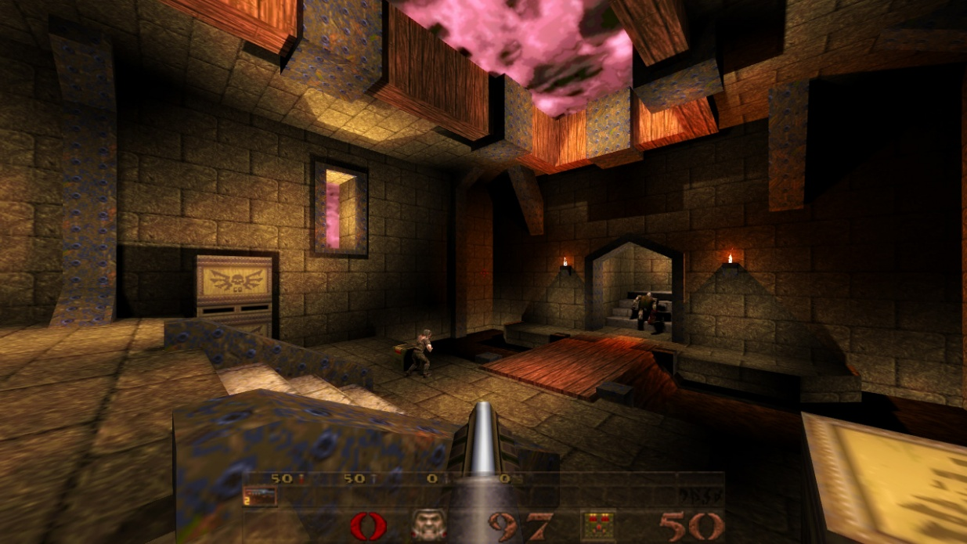
Ray Tracing for Games
Game Development
Purpose of creating games:
Fun, creative
Raising the bar
Virtual worlds & immersion, rules
Real-time

Slide 13
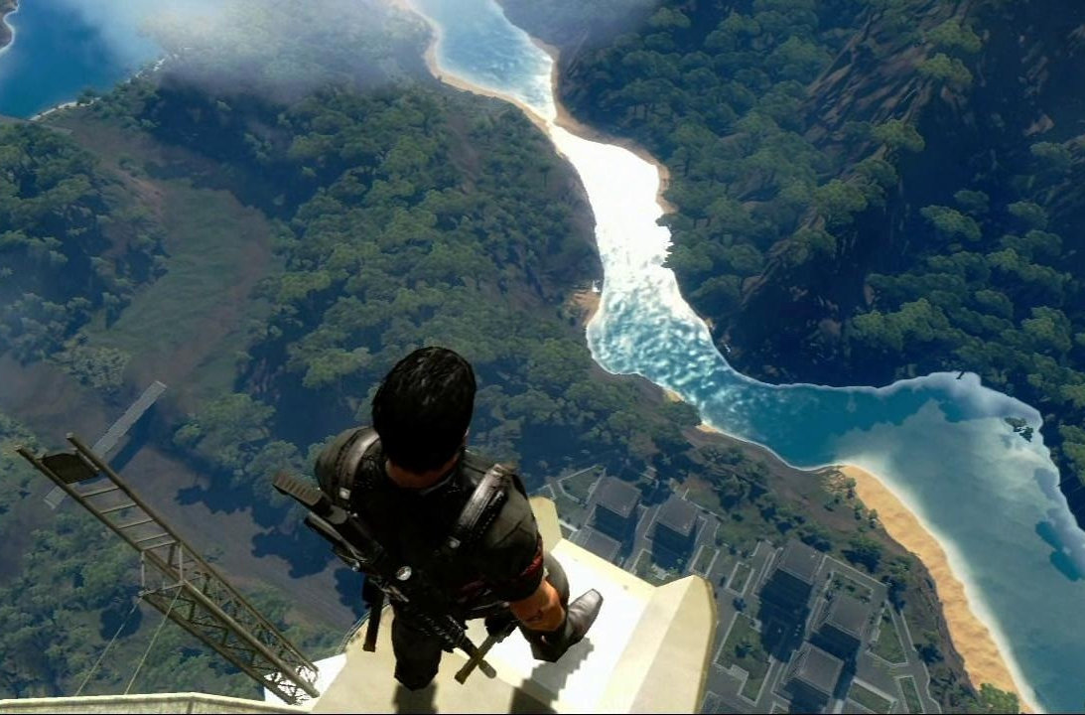

Ray Tracing for Games
Game Development
Purpose of creating games:
Fun, creative
Programming
Visual Art
Audio
Game Design
Management, Q&A, marketing

Slide 14
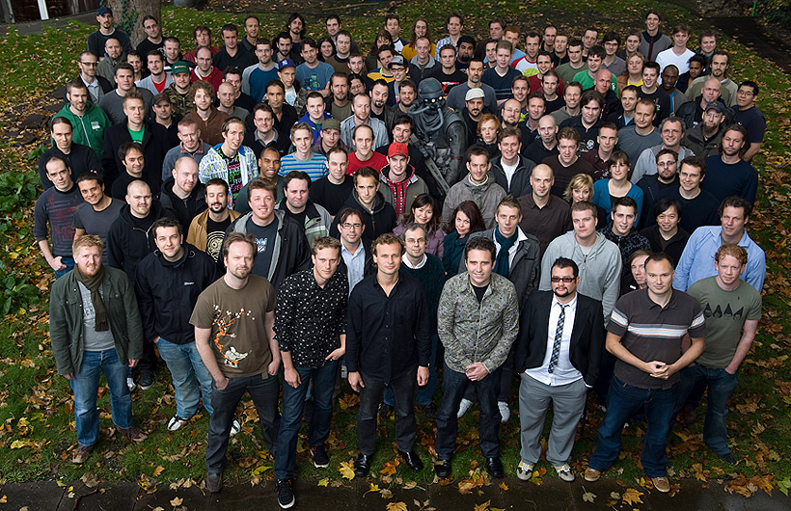
Ray Tracing for Games
Game Development
Purpose of creating games:
Fun, creative
Programming
AI
Game logic
Architecture
Physics
Graphics
Visual Art scenery, props, animation, textures
Audio music, sound fx
Game Design
Management, Q&A, marketing

Slide 15

Ray Tracing for Games
Game Development
Purpose of creating games:
Raising the bar
Driving innovation
Applied research
Simulation: math intensive
And, increasingly:
Physically based.

Slide 16

Ray Tracing for Games
Game Development
Purpose of creating games:
Virtual worlds & immersion, rules
Training, imagining, competition, playing
…without real-world consequences
…but with clear rules.
Realism
suspension of disbelief
accuracy of simulation
wonder

Slide 17

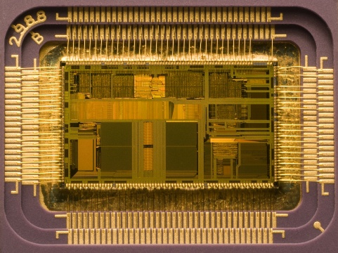
Ray Tracing for Games
Game Development
Purpose of creating games:
Real-time
30Hz? 60Hz? 120Hz?
8-33ms for billions of calculations

Slide 18
Ray Tracing for Games
Game Development
This course: focus on performance and engine development.
Optimized C++
‘Close to the metal’ style of coding
SIMD
…but only for the 1% code that needs it.
This lecture: introduction to game architecture.
Details on Wednesday - Friday

Slide 19
Ray Tracing for Games
Agenda:
Introduction
Game development
Game Architecture
Project Introduction

Slide 20
Ray Tracing for Games
Game Architecture
General architecture:
Init
Main loop
User input
Rendering
Audio
Game logic
AI
Network
Streaming
Tick
Things to do ‘tick’:
Pacman
Continue tile move
Next animation frame
Check joystick
Check collisions
Ghosts
Pills
Walls
Fruit
Warp gates
Audio
Add some ms to waveout
Ghosts
Fruit
ACTORS
~20ms

Slide 21
Ray Tracing for Games
Game Architecture
Tick
The “Actor” abstract base class
class Actor
{
public:
virtual void Tick() = 0;
};
Actor actor[10];
class Pacman : public Actor {};
class Ghost : public Actor {};
class Blinky : public Ghost {};
class Clyde : public Ghost {};

Slide 22
Ray Tracing for Games
Game Architecture
Tick
The “Actor” abstract base class
(Double) linked list
ActorList actor container
From here:
actorList->Tick() updates everything;
Actors can remove themselves.
class Actor
{
public:
virtual void Tick() = 0;
Actor* prev, *next;
};
class ActorList
{
public:
void Tick();
void Add( Actor* actor );
void Remove( Actor* actor );
Actor* list;
};
ActorList actorList;

Slide 23
Ray Tracing for Games
Game Architecture
Tick
The “Actor” abstract base class
Making your game frame rate aware
class Actor
{
public:
virtual void Tick( float dt ) = 0;
Actor* prev, *next;
};
class ActorList
{
public:
void Tick( float dt );
void Add( Actor* actor );
void Remove( Actor* actor );
Actor* list;
};
ActorList actorList;

Slide 24
Ray Tracing for Games
Game Architecture
Tick
The “Actor” abstract base class
Making your game frame rate aware
Memory management
Do not use stl here!
Decide who will own the bulletList and deletedBullets.
class Actor{…}
class ActorList{…}
class Bullet : public Actor {…}
ActorList bulletList;
ActorList deletedBullets;
Bullet* NewBullet()
{
if (deletedBullets.list == 0)
return new Bullet();
Actor* bullet = deletedBullets.list;
deletedBullets.list = bullet.next;
return bullet;
}

Slide 25
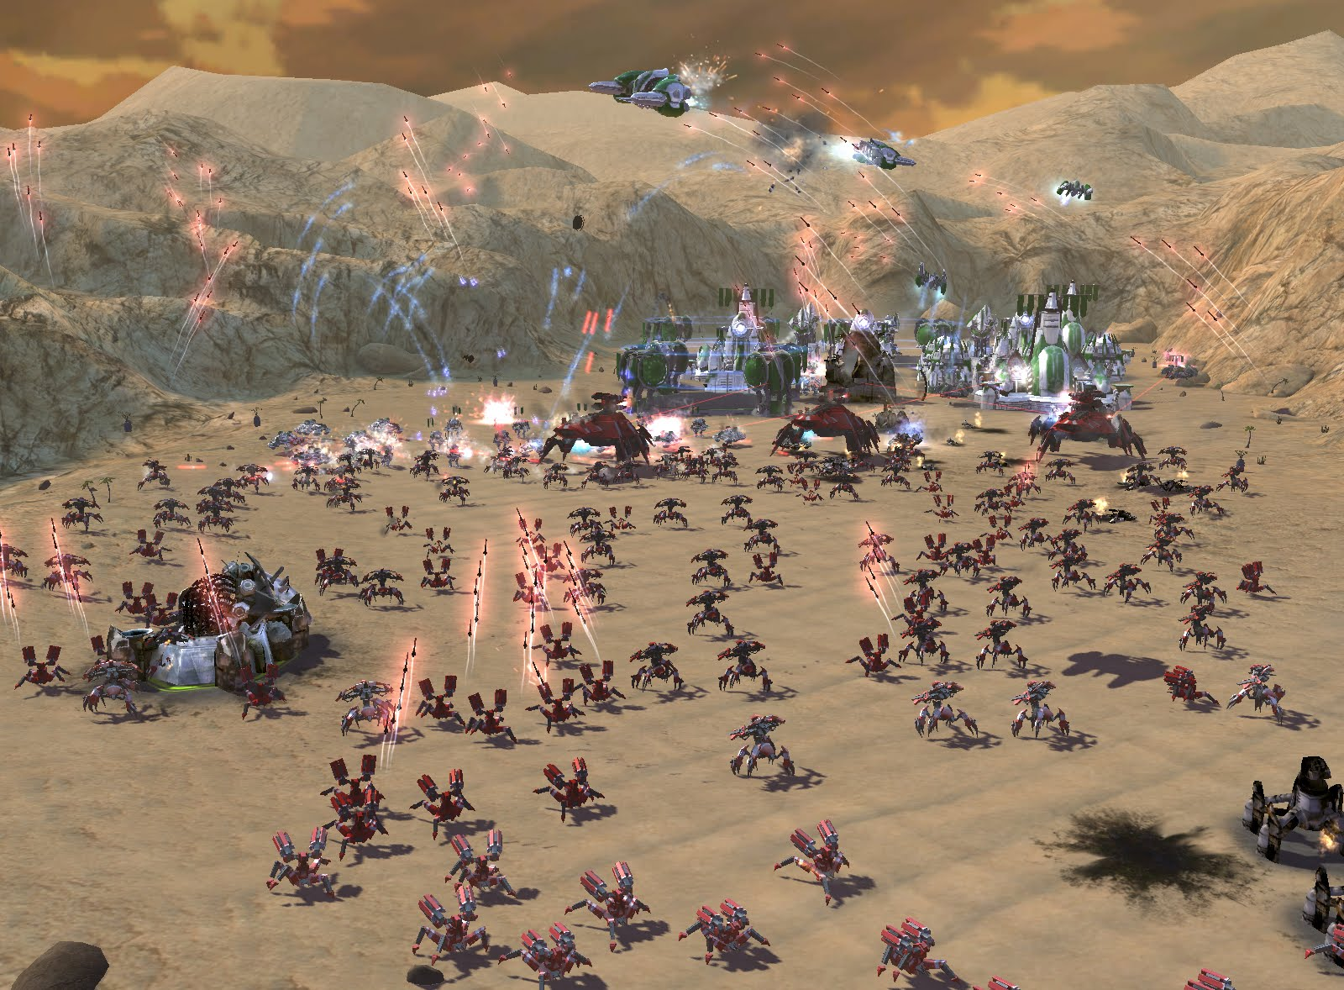
Ray Tracing for Games
Game Architecture
World State
World:
Scene graph
Skybox
Player:
Camera
Unit selected
Score
Per unit:
Actor
Mesh
Other things:
Sounds, mouse position, AI state, …

Slide 26
Ray Tracing for Games
Game Architecture
World State
World:
Scene graph
Skybox
Player:
Camera FOV, focal plane, exposure, …
Unit selected
Score
Per unit:
Actor position, direction, animation, …
Mesh texture, normalmap, …
Other things:
Sounds, mouse position, AI state, …

Slide 27
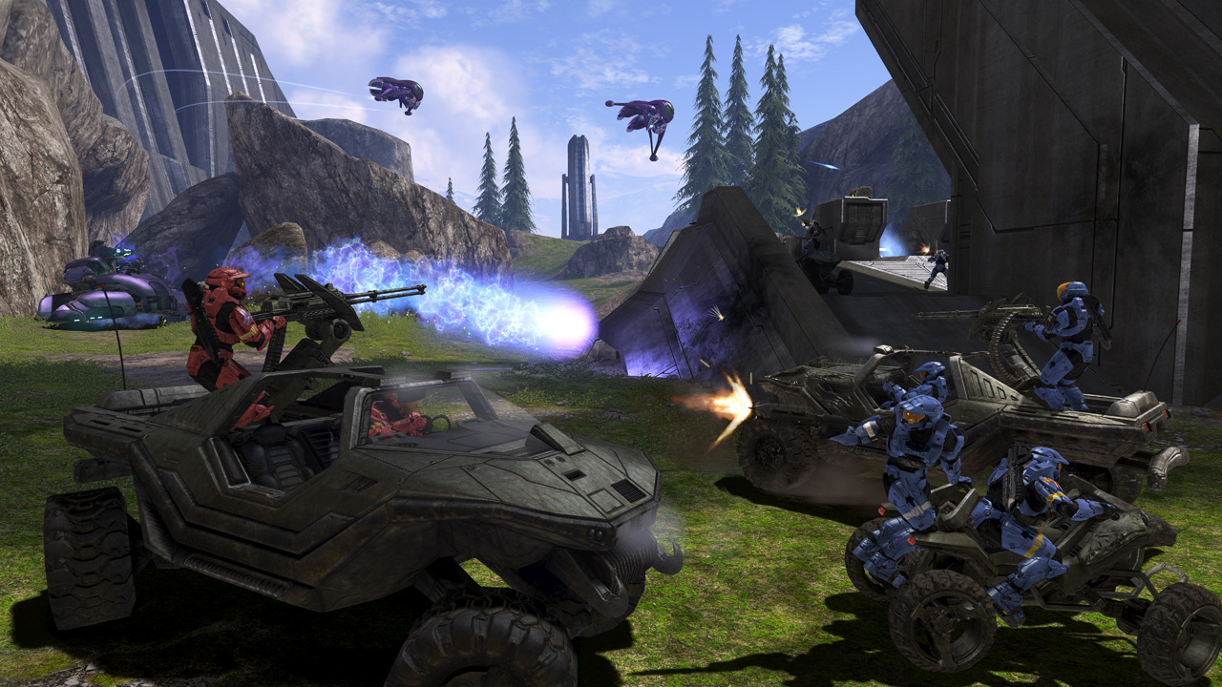
Ray Tracing for Games
Game Architecture
Scene graph
world
car
plane
car
plane
buggy
wheel
wheel
wheel
wheel
wheel
wheel
wheel
wheel
wheel
wheel
wheel
wheel
turret
turret
dude
dude
dude

Slide 28
Ray Tracing for Games
Game Architecture
void SGNode::Render( mat4& T )
{
mat4 M = T * localTransform;
if (GetType() == SG_MESH) ((Mesh*)this)->Render( M );
for( int i = 0; i < child.size(); i++ ) child[i]->Render( M );
}
Each scene graph node has:
A mesh
A transform
Child nodes (zero or more)
M = M_{world} x M_{car} x M_{turret} x M_{dude}
Scene graph
world
car
plane
car
plane
buggy
wheel
wheel
wheel
wheel
wheel
wheel
wheel
wheel
wheel
wheel
wheel
wheel
turret
turret
dude
dude
dude

Slide 29
Ray Tracing for Games
Game Architecture
Data Ownership
Who owns:
The scene graph?
The meshes in the scene graph?
The textures in those meshes?
The actors?
The camera?
class TextureManager
{
public:
~TextureManager();
Texture* GetTexture( char* name );
Texture* GetTexture( int id );
Texture** textures;
};

Slide 30
Ray Tracing for Games
Game Architecture
Data Ownership
How do we kill:
The meshes in the scene graph?
The textures in those meshes?
The scene graph?
The actors?
When do we kill them?
(may want to consider reference counted pointers)
SGNode::~SGNode()
{
for( int i = 0; i < childCount; i++ )
delete child[i];
};

Slide 31
Ray Tracing for Games
Agenda:
Introduction
Game development
Game Architecture
Project Introduction

Slide 32
Ray Tracing for Games
Project Introduction
LAB SESSION 1:
Create a game.
Build the game using the supplied software rasterizer.
Limit the scope so that you have something on the screen today or tomorrow.
Keep the scope open so that the gameplay programmer has something to do for the next 9 days.

Slide 33
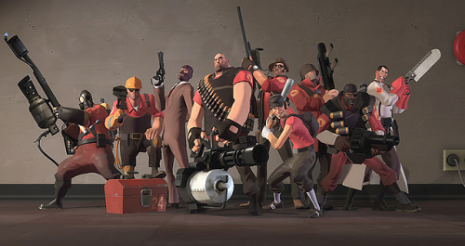
Ray Tracing for Games
Project Introduction
LAB SESSION 1:
Create a game.
Step 1: Form a team.
You will need:
1 graphics programmer
1 gameplay programmer
1 tools & art guy

Slide 34
Ray Tracing for Games
Project Introduction
LAB SESSION 1:
Create a game.
Step 1: Form a team.
You will need:
1 graphics programmer
1 gameplay programmer
1 tools & art guy
Step 2: Select your mission.
Options:
A project focusing on graphics
A project focusing on the game.

Slide 35

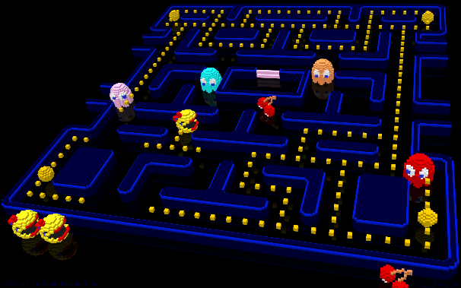
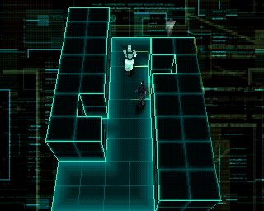
Ray Tracing for Games
Project Introduction
LAB SESSION 1:
Create a game.
Step 3: Select a game design.
Suggestions:
An F1 racing game
Pacman 3D
3D break-out
Top-down Metal Gear clone
(remember: 9 days)

Slide 36
Ray Tracing for Games
Project Introduction
LAB SESSION 1:
Create a game.
Step 3: Select a game design.
Suggestions:
An F1 racing game
Pacman 3D
3D break-out
Top-down Metal Gear clone
(remember: 9 days)
Step 4: Assign roles.
Who’s the graphics guy?
Will you have two of those?
Or will one guy focus on gameplay?
You also need an assets / tools guy.
(it’s also an option do share roles / organize dynamically)

Slide 37

Ray Tracing for Games
Project Introduction
LAB SESSION 1:
Create a game.
Step 5: Alpha.
Identify actors, create classes, implement behavior, handle user input.
Use dummy art, let the assets guy fix it into something nicer.
AIM: have something that works in 3-6 hours.

Slide 38
Ray Tracing for Games
Project Introduction
LAB SESSION 1:
Create a game.
Step 5: Alpha.
Identify actors, create classes, implement behavior, handle user input.
Use dummy art, let the assets guy fix it into something nicer.
AIM: have something that works in 3-6 hours.
TOMORROW:
Introduction to ray tracing.
For today, keep in mind:
We’ll be working towards a ‘take a photo’ button that activates a slow ray tracer.

Slide 39

End of lecture 1.
začněme programování!

